Slide 1
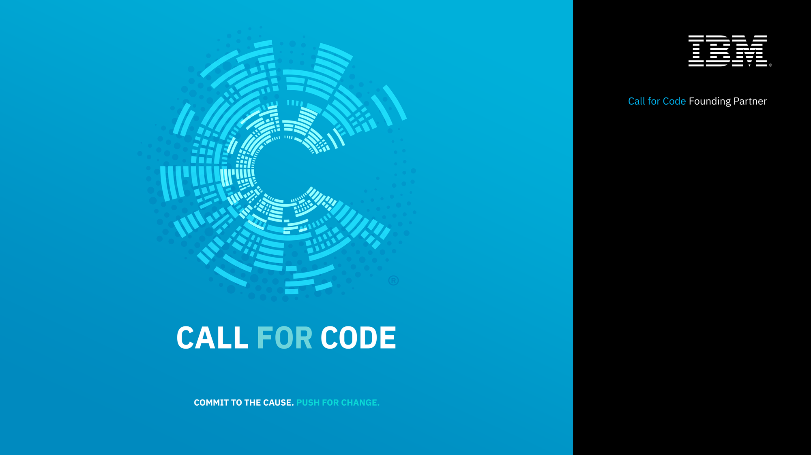

Slide 2
CALL FOR CODE DAY – Workshop Agenda
Kickoff
Disaster – Experience story
Coding for a cause
Call for code Registration
Technology Outlook – Cloud , AI and IoT Services
Lunch
Solution to Problems
Application architecture flow based on IoT, Weather, Blockchain , AI
Demo
Hands On
Ideation

Slide 3
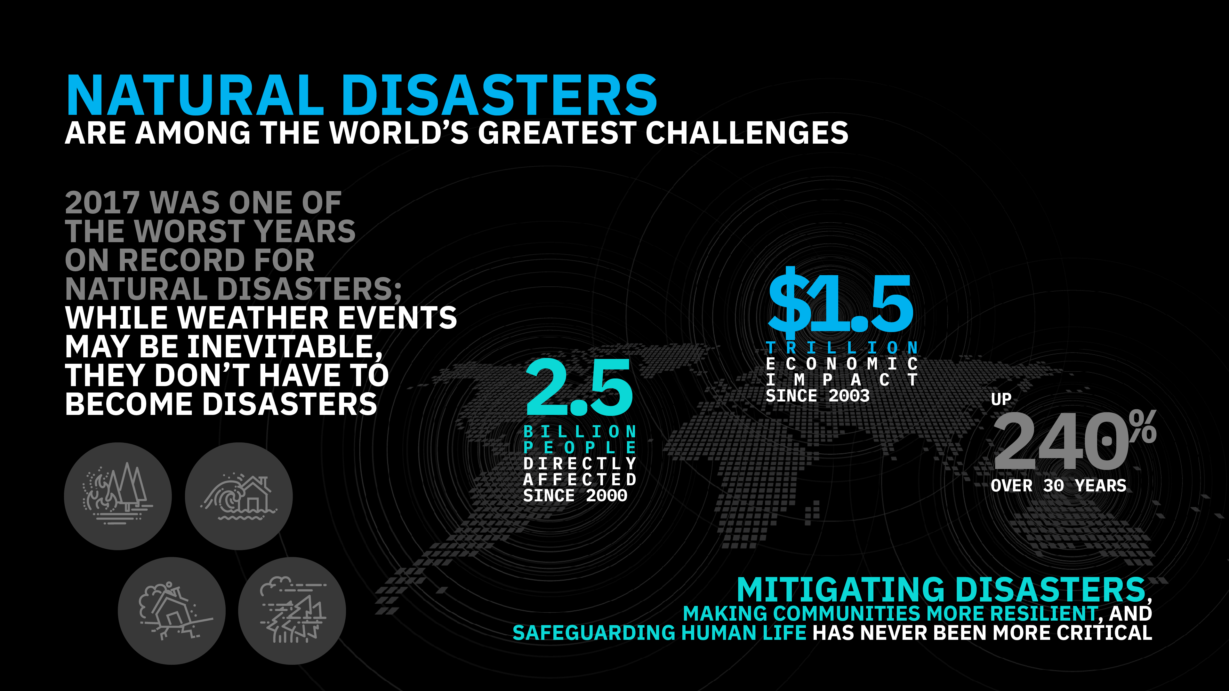
Notes:
Through our long history of working with the world’s developers, particularly in the open source community, we know their impact as the builders of modern business. We also know, through our long history of leading the industry to leverage technology for societal good, that developers can have a similar impact as the builders of a better society – both in ethical considerations for how technology is built and more directly in the use of their skills to address some of the most pressing problems of our modern world.
Caused by Movement of earth : occur with the minimum amount of warning and include earthquakes, volcanic eruptions and tsunamis. They are difficult to predict and impossible to stop. All that can be done is to take appropriate action to limit damage and loss of life after they occur.
Weather related disasters: hurricanes, tornadoes, extreme heat and extreme cold weather.
Floods, mudslides, landslides and famine. Badrinath Landslide ( Uttarakhand ) May 20, 2017 - Nearly 14,000 pilgrims were left stranded at various places in Chamoli district after a massive landslide

Slide 4
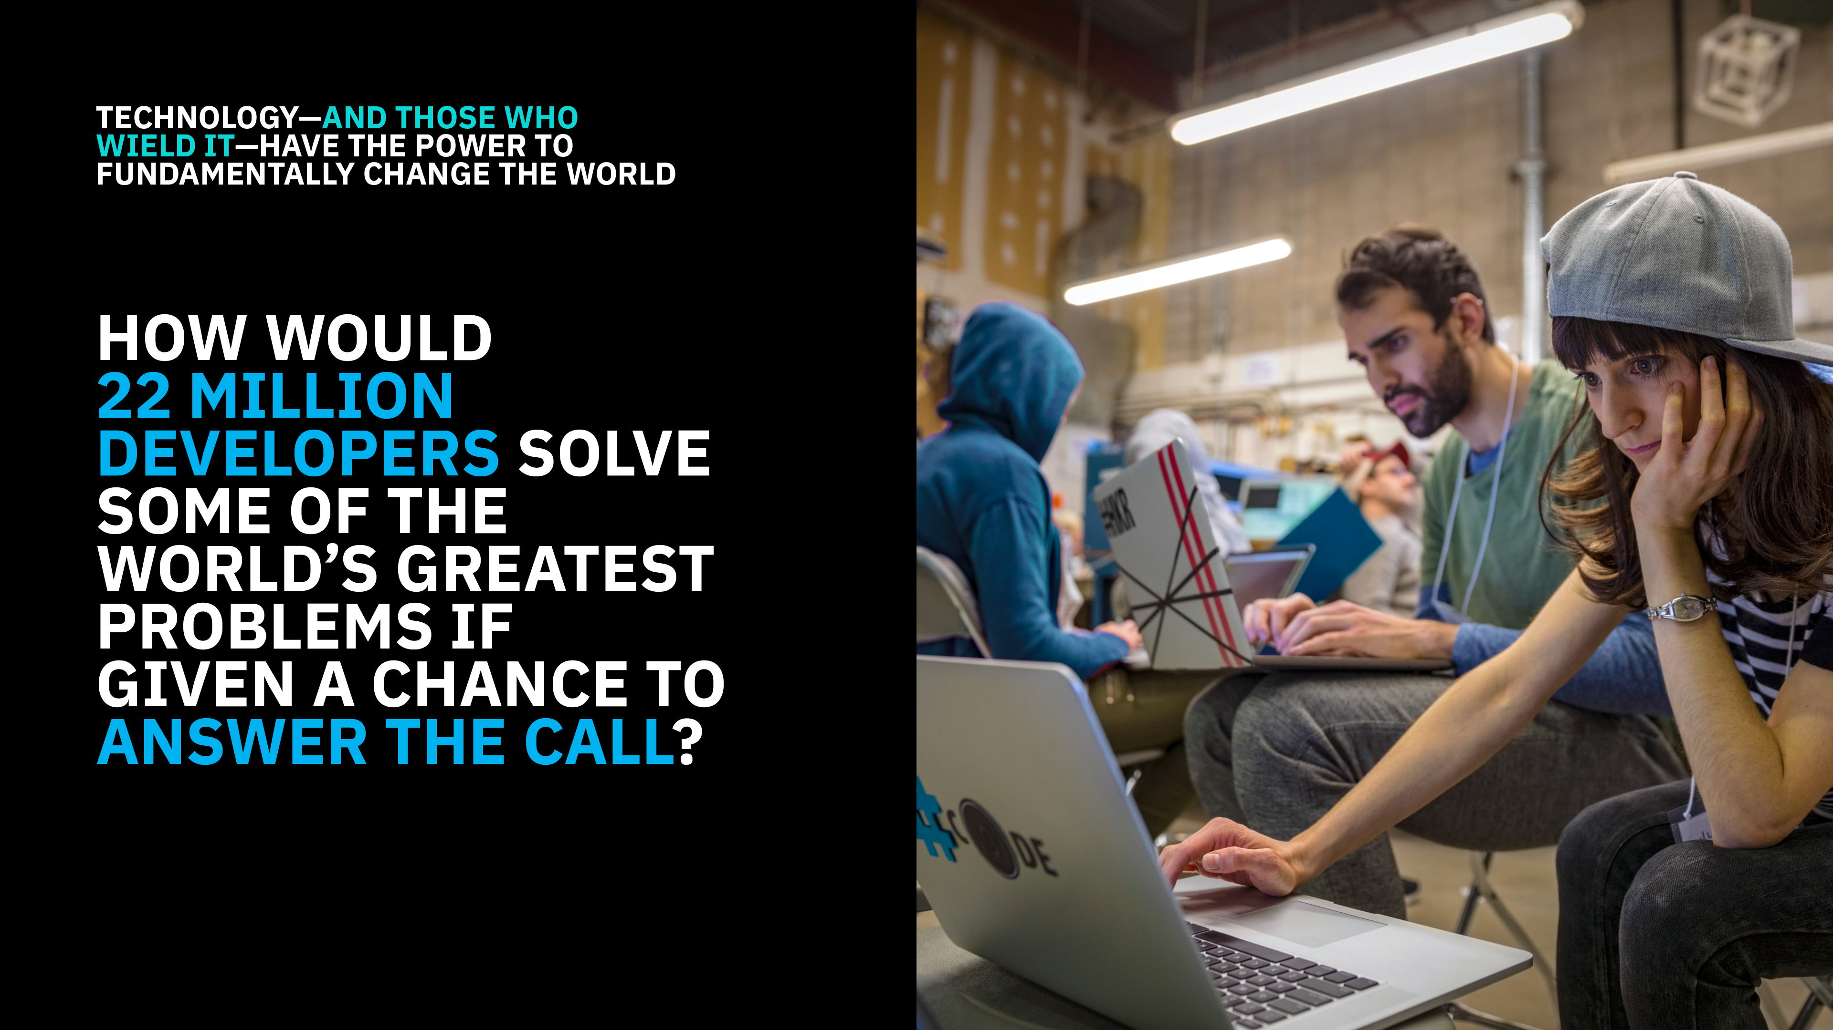
Notes:
Linux foundations
How Weather and Technology make positive impact to Business over the globe. Non profit organizations, people safe in weather and climate hazards.
UN Nations
There has been increase in Natural disasters over the period. Typhoon,
Global initiatives,
Respond to crisis to take care of human rights, integration is must
Encouraging the developer communities to develop solutions which will help for Disaster preparedness. How new technologies like AI, BlockChain would be leveraged to develop powerful solutions.
Technology is powerful tool to solve such Natural Disasters. Call For code is a challenge for technical developers., to solve this world problem.
American Red Cross:. If we could get people What they need? Where they and when they need? Disasters and logistics business for : to alleviating the people suffering.
Multiple locations delivered, to automobiles/trains/. Mobilization and movement of those resources. Massive Challenges.
Where Technology would help:
Geospatial Technology: Where is need, its more
Where is the damage?…flood/fire/organic lava…..better decision by Visualizing data for better di…for movement of people/vehicle/material….
CLOUD, BLOCKCHAIN , AI : Predictive Analytics, greatest need – based on weather
3 Characters
Ageing – changing need
Aggressiveness : Where, What :
Speed to scale in advance: Emergency management services to understand : technology to predict need for managing scarcity
Developers:
Disaster : damage assessment in – Long time recovery to be reduced…..by using technology : to detail damage assessment by home, walk on the read
Flood and frequent disaster. Understand Longer term need: is it ? Power infra . Food, Water safety /water security . Build in a resilient factor. To benefit from technology.
More resilient communities.
Last decade: people suffering being helped in past 5 years, scientist and analyst can help alleviate these problems
Angel Diaz: developers
Open source communities to build better system:
Preparing for disaster : Hurricanes..
Software makes more difference:
Medicine : medical supplies,
Opening minds to everybody to use IBM Cloud, Technologies,
Judging/….Answer the call
Development is being different than what it was a decade back. 10,000 Developers are already
Responsibility : Wining submission pn IBM is Deploy live in field…Linux, wining a Ecomic prize, see stuff live in real world
Oppoutiny to work with IBM
Great idea: but not developers:
Call for code and amplify tweet..
Join team
What happens to code
Apache 2.0 license: source code
Linux will host and code and open source community. Continue to work with community

Slide 5

Call for Code inspires developers to solve pressing global problems with sustainable software solutions, delivering on their vast potential to do good.
Bringing together NGOs, academic institutions, enterprises, and startup developers to compete build effective disaster mitigation solutions, with a focus on health and well-being.
The American Red Cross, and the United Nations Office of Human Rights combine for the Call for Code Award to elevate the profile of developers.
Award winners will receive long-term support through open source foundations, financial prizes, the opportunity to present their solution to leading VCs, and will deploy their solution through IBM’s Corporate Service Corps.
Developers will jump-start their project with dedicated IBM Code Patterns, combined with optional enterprise technology to build projects over the course of three months.
Judged by the world’s most renowned technologists, the grand prize will be presented in October at an Award Event.

Slide 6
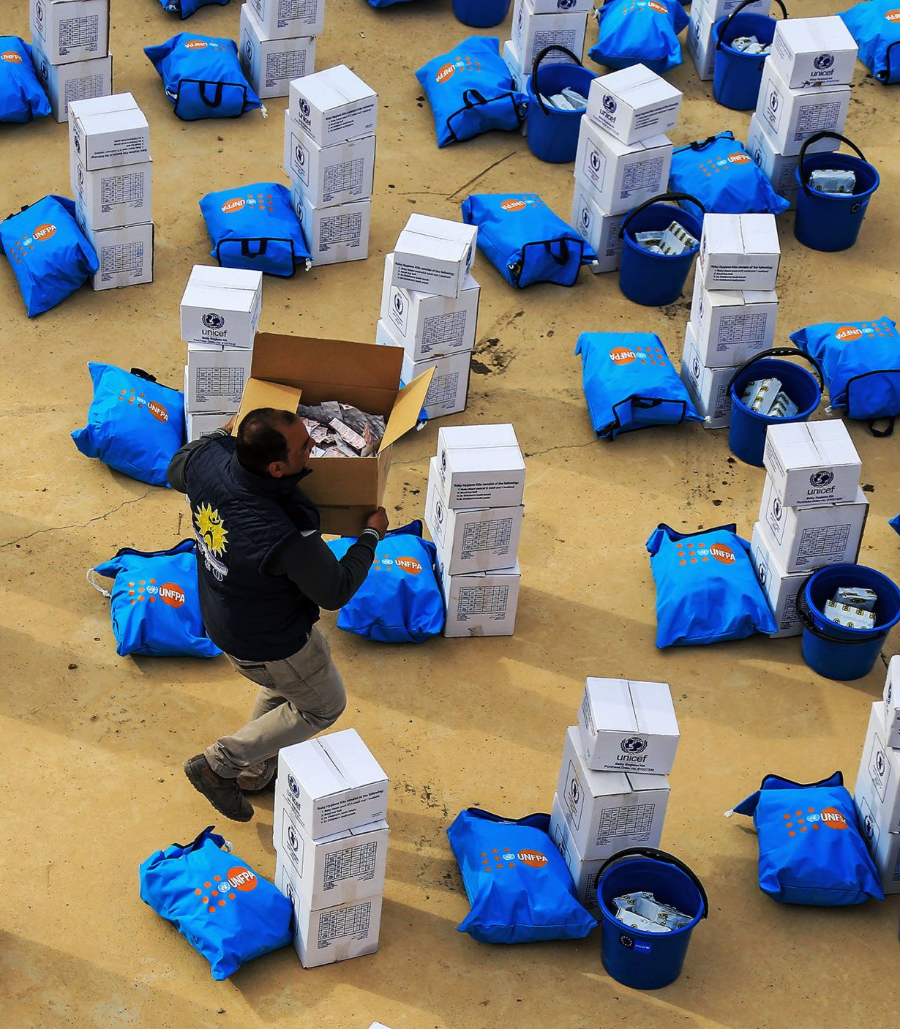
Code Patterns
Build a blockchain network
Deploy an asset-transfer app using blockchain
Create a real-time payments application
Track financial donations with blockchain
Automate business processes via blockchain events
Create financial applications using APIs on mainframe
Build resilient financial networks to execute secure transactions quickly
developer.ibm.com/callforcode/resources/financial-networks/

Slide 7
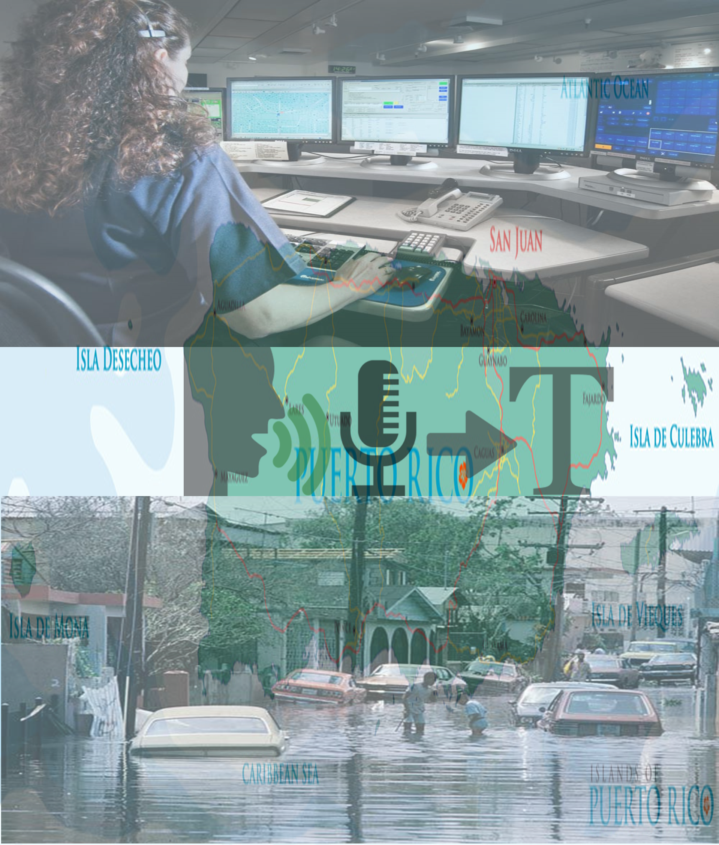
Code Patterns
Create a mobile written Hangul translation app
Analyze Twitter handles and hashtags for sentiment and content
Deploy a serverless multilingual conference room
Create an app to perform intelligent searches on data
Translate
voice and written communications on the fly to improve information sharing
developer.ibm.com/callforcode/resources/translate/

Slide 8

Code Patterns
Classify ICD-10 data with Watson
Develop a web-based mobile health app that uses machine learning
Create and deploy a scoring model to predict heart rate failure
Create visualizations to understand food insecurity
Analyze open medical datasets to gain insights
Understand, analyze, and predict healthcare and nutrition needs to improve basic services
developer.ibm.com/callforcode/resources/healthcare/

Slide 9
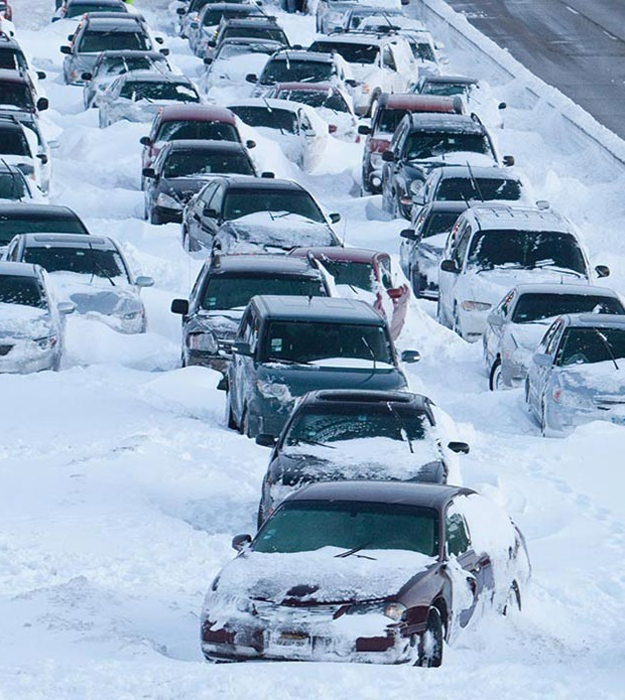
Code Patterns
Build a cognitive recommendation app with Swift
Correlate flight and weather data in an augmented reality mobile app
Create charts, graphs, and maps using open city datasets
Create a simple chatbot with Node.js and Watson Assistant
Improve logistics based on traffic and weather activity to reduce number of people affected
developer.ibm.com/callforcode/resources/traffic-and-weather/

Slide 10
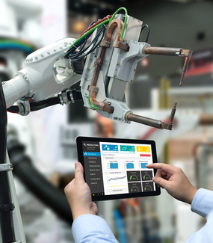
Code Patterns
Analyze industrial equipment for defects
Detect voltage anomalies in household IoT devices
Develop an IoT asset tracking app using Blockchain
Analyze device sensor data to take corrective or preventative action automatically
developer.ibm.com/callforcode/resources/preventative-action/

Slide 11
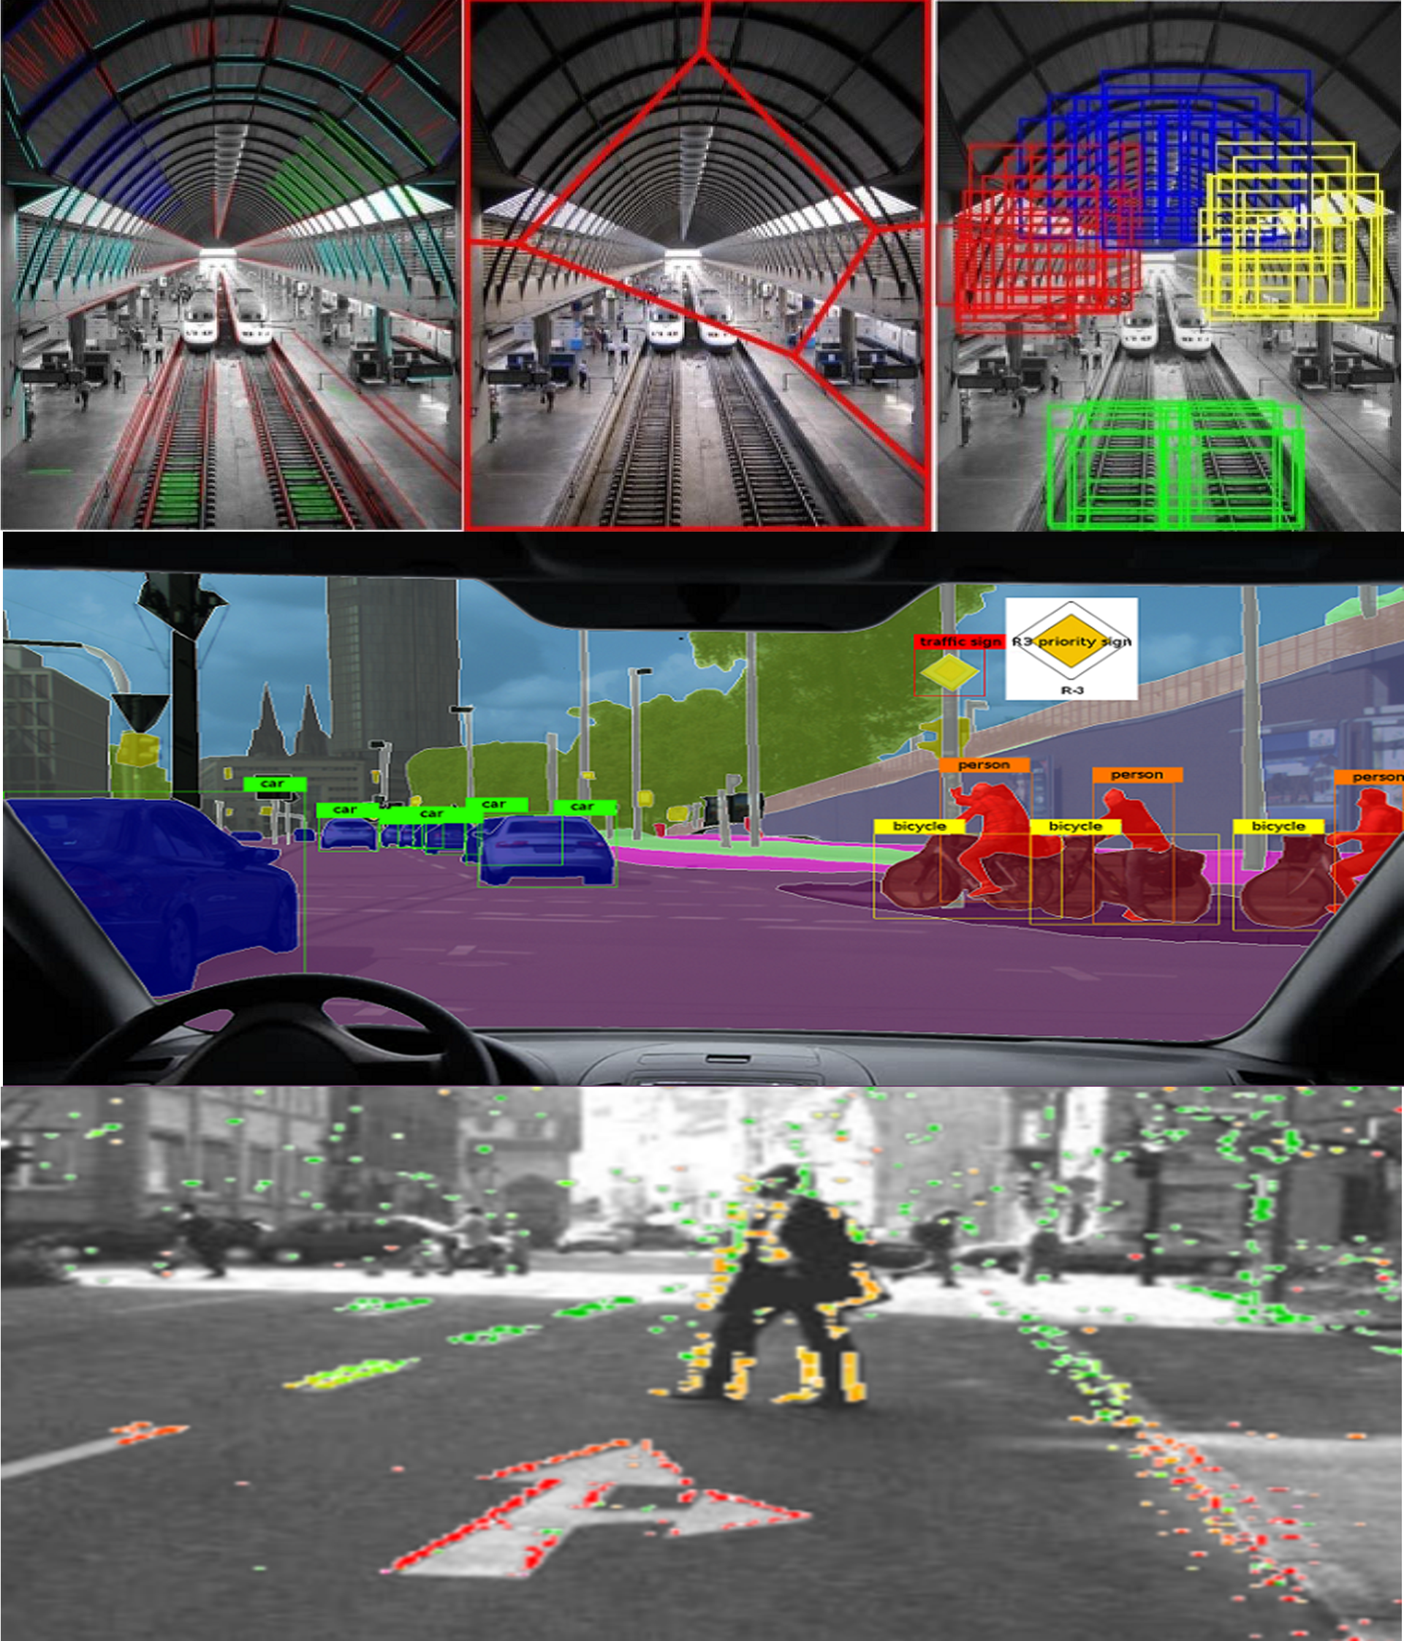
Code Patterns
Build an iOS game powered by Core ML and Watson Visual Recognition
Locate and count items in an image with object detection
Classify vehicle damage images
Use visual recognition to process claims quickly or identify immediate need for aid
developer.ibm.com/callforcode/resources/visual-recognition/
Notes:
Apply cognitive to classify and tag mobile images on the go
Build a web-based blockchain insurance application
Locate and count items in an image with object detection (Uses Power AI, that's OK)
Classify vehicle damage images
Analyze an image and send a status alert (Needs fix - https://github.com/IBM/image-analysis-iot-alert/issues/9 appears to be an API usage problem, maybe Watson Vision changed, waiting on maintainer response)

Slide 12
REGISTRATION

Slide 13
Technology Outlook – Cloud , AI and IoT Services

Slide 14

IBM Cloud has IaaS / PaaS services in ONE Cloud Platform
Industry
IoT
Block Chain
Health
Financial
Services
Media
Discovery
Conver-sation
Natural Language
Speech & Vision
Tradeoff Analytics
Retrieve & Rank
Cognitive
Data & Analytics
Database
Data
Data Management
Analytics
Visualize
Messaging
Mobile
App Security
API & Integration
DevOps
Developer Tools
Containers
Cloud Foundry
Event-Driven
Run-Times
Compute
Storage
Network
Infrastructure
Virtual Servers
Bare Metal
VMware
Block
Object
File
Public
Private
VPN
CDN
Public
Dedicated
Local
Multi-Tenant
Single-Tenant
Single-Tenant
IBM Cloud
Client
Notes:
IBM Cloud has cloud services that span IaaS and PaaS
From Infrastructure right up to Industry cloud solutions
Through IBM Cloud, users are able to choose the level at which they wish to operate
They can do it themselves at the infrastructure level (IaaS)
They can let IBM manage the infrastructure and concentrate on DevOps at the PaaS level
Or they can leverage both IaaS and PaaS in any combination they wish
E.g. A workload might run in a VSI or a Bare Metal service but the user may wish to leverage DBaaS instead of managing the database themselves

Slide 15
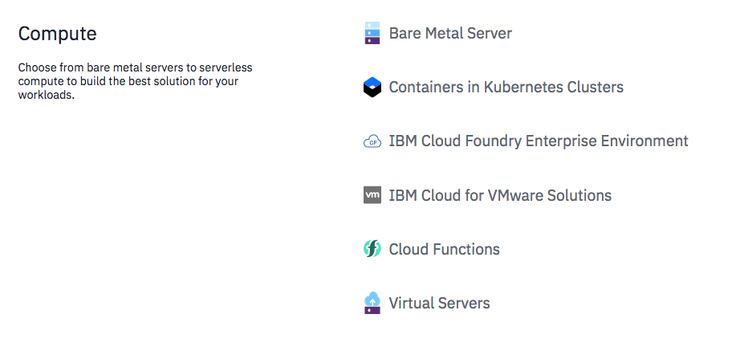
Choose Compute

Slide 16
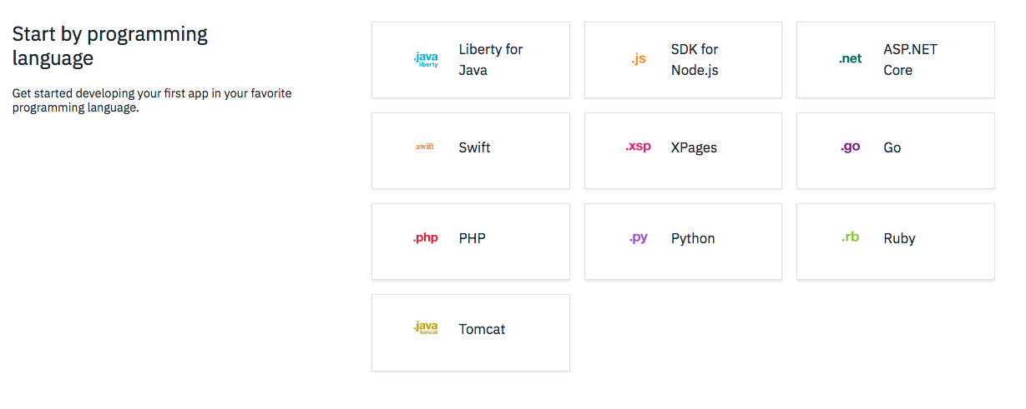
Choose Programming Language

Slide 17
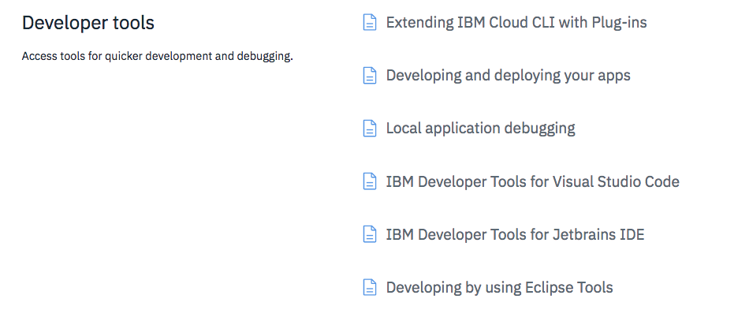

Slide 18
Watson Services
Assistant
SDKs and code samples at github.com/watson-developer-cloud
Notes:
IBM Watson analyzes natural language in text and audio, and images, to extract value that can be used in applications across all industries. For example, a customer service chatbot could listen to a user speak, transcribe the audio with Speech to Text, process the text using Conversation to understand the intents and entities and determine a response, and then speak back the response using Text to Speech. We can also understand the personality of our user with the help of Personality Insights, and emotions using Tone Analyzer / Natural Language Understanding.

Slide 19
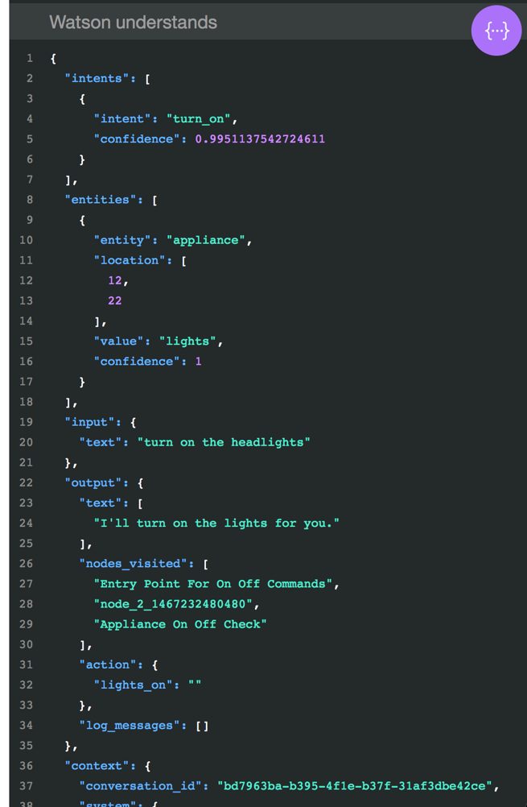
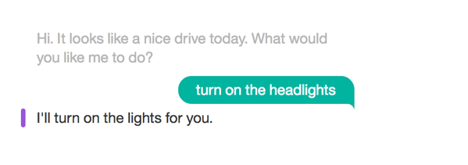

Watson Assistant
Quickly build and deploy chatbots and virtual agents across a variety of channels, including mobile devices, messaging platforms, and even robots.
ibm.biz/demo-assistant

Slide 20
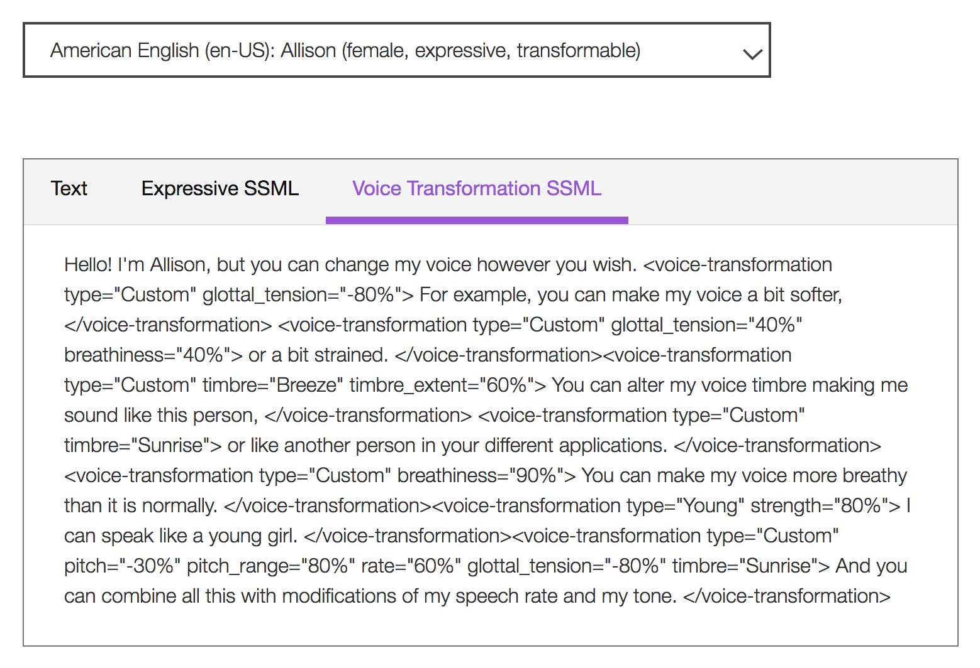
Text to Speech
Understand text and natural language to generate synthesized audio output complete with appropriate cadence and intonation. It is available in 13 voices across 7 languages.
ibm.biz/demo-text-to-speech

Slide 21
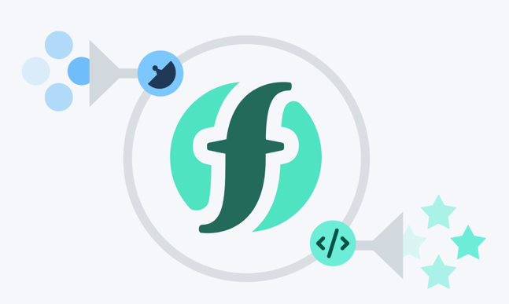
IBM Cloud compute services
Cloud Foundry runtimes
deploy app without managing infrastructure
Java, Node.js, Swift, ASP.NET Core, Python, PHP, Ruby, Go...
Cloud Functions "serverless"
trigger actions from events
or REST API calls
Notes:
IBM Watson analyzes natural language in text and audio, and images, to extract value that can be used in applications across all industries. For example, a customer service chatbot could listen to a user speak, transcribe the audio with Speech to Text, process the text using Conversation to understand the intents and entities and determine a response, and then speak back the response using Text to Speech. We can also understand the personality of our user with the help of Personality Insights, and emotions using Tone Analyzer / Natural Language Understanding.

Slide 22
IBM Cloud compute services
Kubernetes clusters
Run scalable container applications without managing infrastructure
Connect with over 170 IBM and third-party services
Cloud Infrastructure
Bare Metal and Virtual Servers with scalable, dedicated core and memory allocations
Storage and networking services you control
Notes:
IBM Watson analyzes natural language in text and audio, and images, to extract value that can be used in applications across all industries. For example, a customer service chatbot could listen to a user speak, transcribe the audio with Speech to Text, process the text using Conversation to understand the intents and entities and determine a response, and then speak back the response using Text to Speech. We can also understand the personality of our user with the help of Personality Insights, and emotions using Tone Analyzer / Natural Language Understanding.

Slide 23
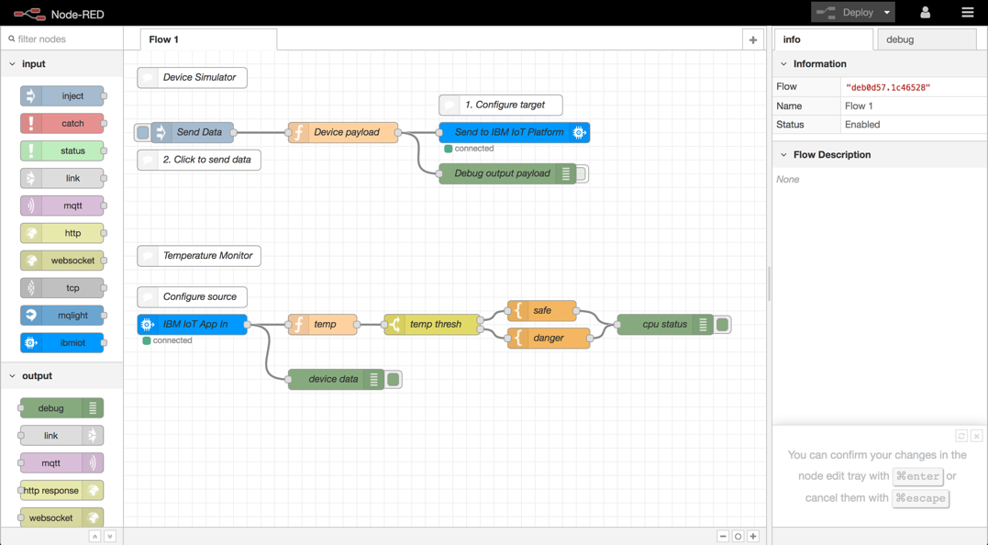


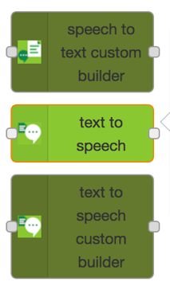
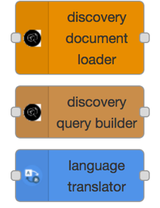
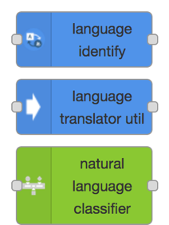
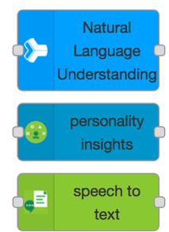
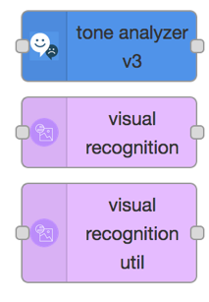
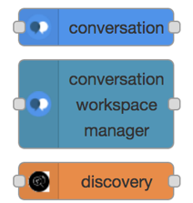
Watson IoT and Node-RED
Quickly build flow-based applications handling sensor events
IoT device input / output nodes
And Watson nodes

Slide 24
CODE PATTERN

Slide 25
Theme #1: “Build secure, resilient, traceable and transparent supply networks with blockchain”
CODE PATTERN: “Track donations with Blockchain”
Complete this pattern to build a simple three-member network using the IBM Blockchain Platform, on which cause-specific pledges and fund transfers are made by the government, registered with aid organizations, and validated by Global Citizen

Slide 26
Theme #2: “Use AI and bots to improve real-time communications with natural language processing”
CODE PATTERN: “Create an app to preform intelligent searches on data”
Develop a web app to extract and visualize enriched data using Node.js and Watson Discovery

Slide 27
Theme #3: “Understand, analyze and predict health and nutrition needs to improve services with data science”
CODE PATTERN: “Analyze open medical datasets to gain insights"
Use machine learning to predict U.S. opioid prescribers with Watson Studio and scikit-learn

Slide 28
Theme #4: ”Improve logistics based on traffic and weather activity to reduce the number of people affected”
CODE PATTERN: “Build a cognitive recommendation app with Swift “
Build a Swift-based mobile chatbot to provide recommendations, reservations, and event planning

Slide 29
Theme #5: ”Collect and analyze device sensor data to take corrective and preventative action automatically”
CODE PATTERN: “Use MQTT to stream real-time data “
Create a real-time stream of carbon intensity for the NY State power grid with MQTT and Kubernetes

Slide 30
Theme #6: ”Use machine learning, deep learning, and visual recognition to improve critical processes”
CODE PATTERN: “Classify vehicle damage images “
Create a custom visual recognition classifier with Apache Cordova, Node.js, and Watson Visual Recognition

Slide 31
CODE PATTERN DEMO

Slide 32
CODE PATTERN Hands On

Slide 33
Ideation

Slide 34
SUBMISSION AND JUDGING NOTES
Working code > Slides
Convey a user-centered story with your demonstration
Show how technologies work together
More tips in the Pitch Workshop!!!
Criteria | Points
Completeness and transferability | 5
Effectiveness and efficiency | 5
Design and usability | 5
Creativity and innovation | 5
Use of IBM and other Call for Code sponsor technology | 5
Idea
User Experience
Implementation

Slide 35
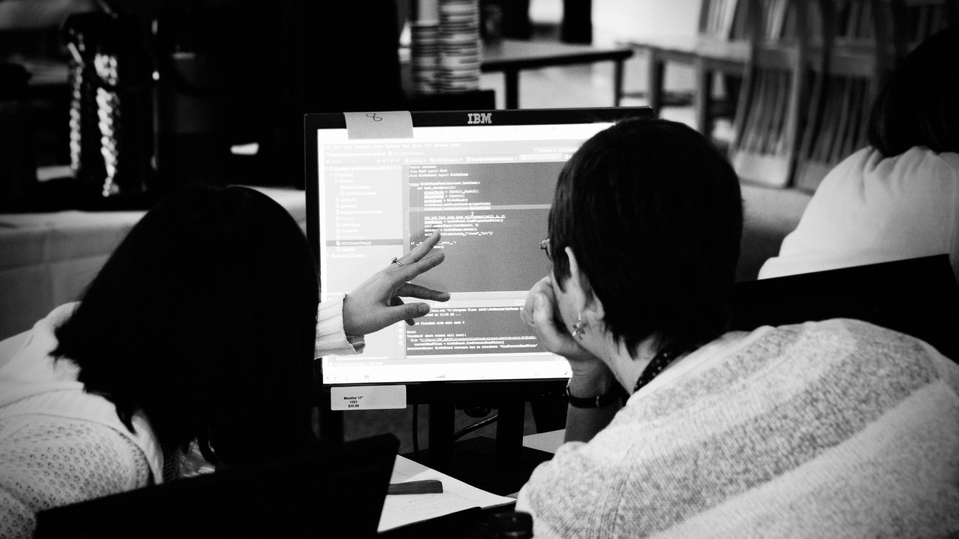
developer.ibm.com/callforcode

